Slide 1
Brazil An. darlingi wings
Results and figures
11/11/2017

Slide 2
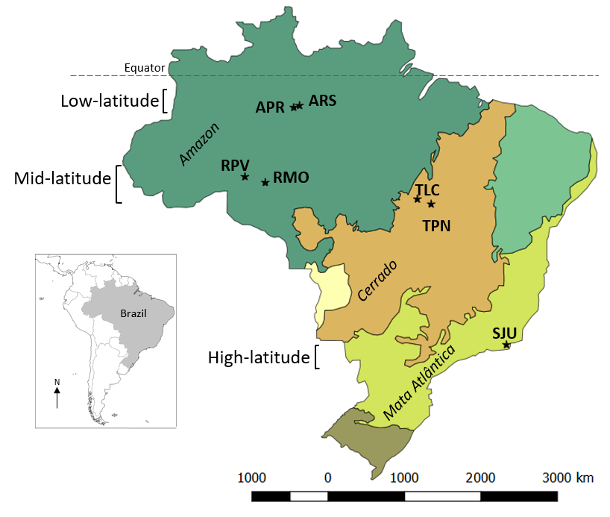
Map of field sites

Slide 3
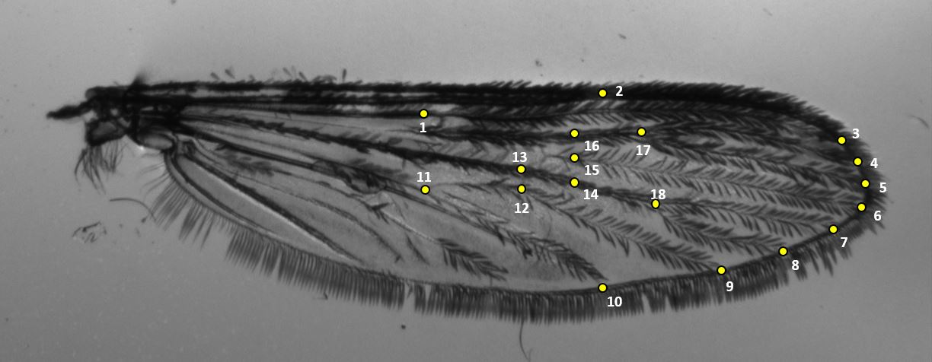
18 landmarks placement (Motoki 2012)

Slide 4
Preliminary data table
Biome | Locality | Latitude | Field (n) | Wing length (avg ± sd) | CS (avg± sd)
Amazon | ARS | -2.864 | 17 | 2.92 ± 0.2 | 2.7 ± 0.18
 | APR | -3.028 | 50 | 2.97 ± 0.18 | 2.75 ± 0.18
 | RPV | -8.742 | 47 | 2.95 ± 0.18 | 2.75 ± 0.16
 | RMO | -9.223 | 45 | 3.02 ± 1.8 | 2.83 ± 0.17
Cerrado | TLC | -10.7 | 54 | 3.09 ± 0.17 | 2.87 ± 0.15
 | TPN | -10.796 | 16 | 3.04 ± 0.17 | 2.89 ± 0.15
Mata Atlantica | SJU | -22.611 | 11 | 3.5 ± 0.1 | 3.26 ± 0.11

Slide 5
Pairwise comparisons of lab reared
I did pairwise comparison with Bonferroni
What does it mean in terms of pop differences at CS level?
SJU CS are significantly different from all other sites.
Field 18 pairwise comparison
 | ARS | APR | RPV | RMO | TLC | TPN
APR | 1
RPV | 1 | 1
RMO | 0.1553 | 0.5854 | 0.3454
TLC | 0.0053 | 0.0065 | 0.0032 | 1
TPN | 0.0195 | 0.0675 | 0.0417 | 1 | 1
SJU | 3.30E-15 | < 2E-16 | < 2E-16 | 1.60E-12 | 1.00E-10 | 2.30E-07
Bonferroni adjustment

Slide 6
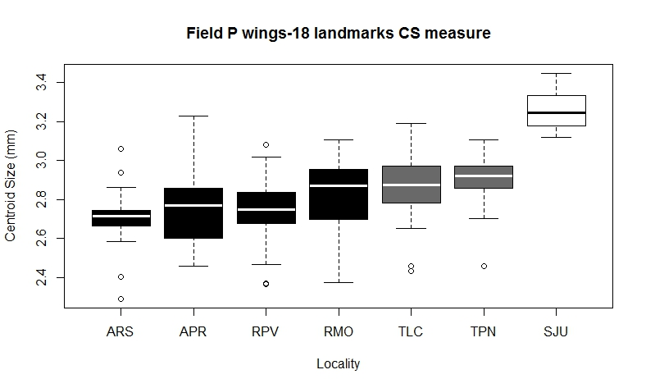
Average centroid size by latitude
Legend
Amazon- Black
Cerrado- Gray
Mata Atlantica- White
-2.864 -3.028 -8.742 -9.223 -10.7 -10.796 -22.611
Notes:
Done in R

Slide 7
Repeatability
Field samples- 240 total
Lab samples- 870 total
On 14.5% of data
Field (n=35) - 99.83%
Lab (n=126) -97.28%
Almost perfect!

Slide 8
Metric Disparity
Metric disparity results, 1000 bootstraps
 |  | FIELD 18 LANDMAKRS
Locality | n | MD | SE | CI left | ci right
ARS | 17 | 1.41E-03 | 0.000151 | 0.001124 | 0.001627
APR | 50 | 1.08E-03 | 7.43E-05 | 0.000966 | 0.001206
RPV | 47 | 1.37E-03 | 0.000216 | 0.001095 | 0.001787
RMO | 45 | 1.05E-03 | 7.28E-05 | 0.000912 | 0.001146
TLC | 54 | 1.17E-03 | 0.000153 | 0.000937 | 0.001433
TPN | 17 | 1.56E-03 | 0.0002 | 0.00121 | 0.001874
SJU | 11 | 7.39E-04 | 9.26E-05 | 0.000615 | 0.000931
Do you have pairwise comparisons to know if there are any significant differences between pops?
Notes:
From CLIC

Slide 9
PAD discriminant analysis
Biome | 1st correct assignment |  | Cross check
Amazon | 137/159 | 86% | 124/159 | 77%
Cerrado | 58/71 | 82% | 51/71 | 71%
Mata Atlantica | 9/11 | 82% | 7/11 | 63%
Location | 1st correct assignment |  | Cross check
ARS | 12/17 | 70% | 5/17 | 29%
APR | 31/50 | 62% | 17/50 | 34%
RPV | 41/47 | 87% | 32/47 | 68%
RMO | 30/45 | 66% | 23/45 | 51%
TLC | 46/54 | 85% | 43/54 | 79%
TPN | 16/17 | 94% | 10/17 | 58%
SJU | 10/11 | 90% | 7/11 | 63%
Wing shape is not a good predictor of location but it is of biome and latitude. Both biome and latitude group (low, mid, high) had similar results, Little difference between classifications?

Slide 10
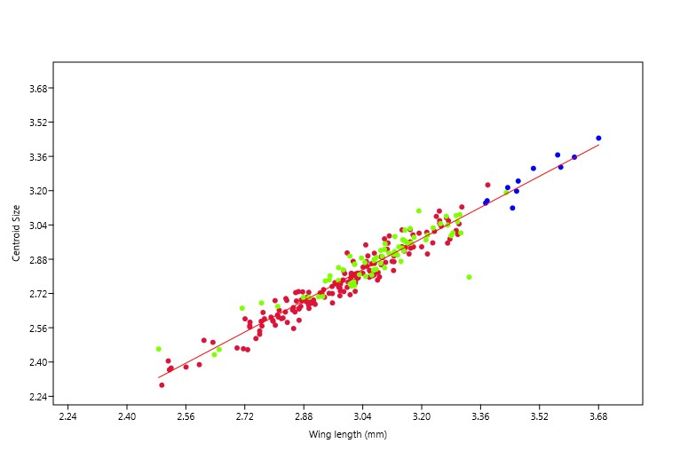
Wing length and CS regression
Legend
Amazon
Cerrado
Mata Atlantica
Confirms CS and wing length are highly correlated
R^2= 0.2296, p< 3.073e-15
Notes:
Done in PAST

Slide 11
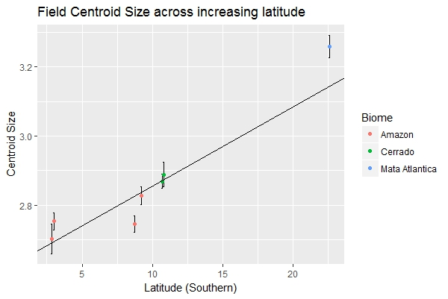
Centroid size over latitudes
Suggests support of a Bergmann cline
R^2=.2642, p<2.2e^-16
Yes!
It supports that!
Notes:
Done in R

Slide 12
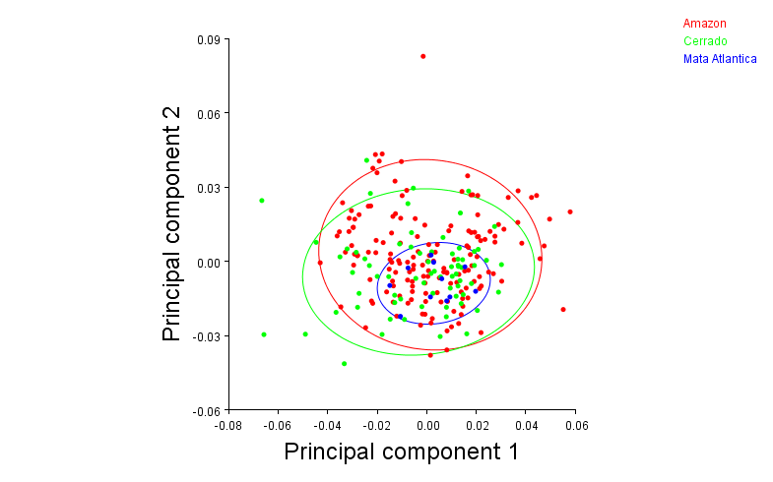
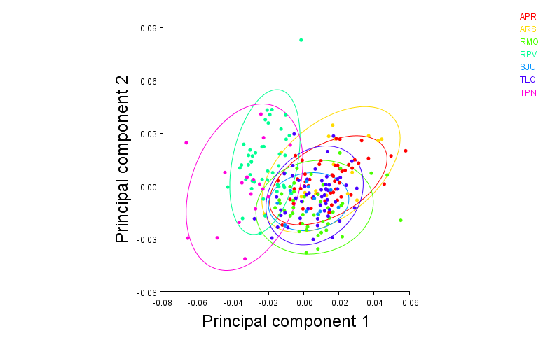
PCA’s by biome and latitude
Some pops look different in terms of wing shape
PC1: 27.94%, PC2: 19.15%
There is not an evident wing shape differentiation among three regions

Slide 13
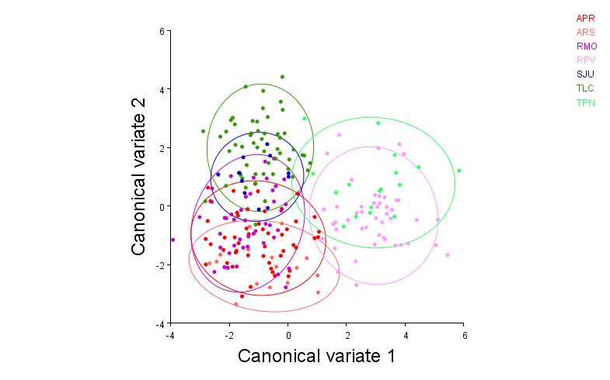
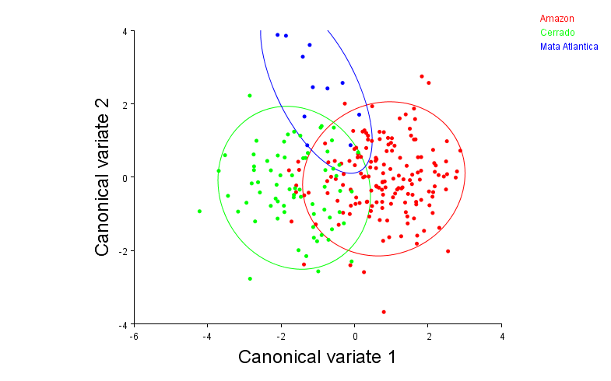
CVA by biome and latitude (10,000 permutations)
CV1: 53.69%, CV2: 27.66%
CV1: 80.71%, CV2: 19.29%

Slide 14
CVA by biome and latitude (10,000 permutations)
Nice results. Both distances support significant mean wing shape differences between pops, except APR-ARS comparison.
Bolded have p-values<0.001
Mahalanobis distances among groups:
 | APR | ARS | RMO | RPV | SJU | TLC
ARS | 1.7895
RMO | 1.8308 | 2.5093
RPV | 4.1091 | 4.4283 | 4.5022
SJU | 3.4508 | 4.1384 | 2.977 | 4.9272
TLC | 3.1466 | 4.2208 | 2.9916 | 4.5649 | 3.014
TPN | 4.8761 | 5.0438 | 4.8565 | 2.7394 | 4.8598 | 4.5795
Procrustes distances among groups:
 | APR | ARS | RMO | RPV | SJU | TLC
ARS | 0.0116
RMO | 0.0186 | 0.0241
RPV | 0.0384 | 0.0399 | 0.0393
SJU | 0.0258 | 0.0306 | 0.0203 | 0.0393
TLC | 0.0184 | 0.0264 | 0.0176 | 0.0361 | 0.0179
TPN | 0.0495 | 0.0515 | 0.0429 | 0.023 | 0.0401 | 0.0424
Mahalanobis distances among groups:
 | Amazon | Cerrado
Cerrado | 2.4605
Mata Atlantica | 3.1149 | 2.8236
Procrustes distances among groups:
 | Amazon | Cerrado
Cerrado | 0.0146
Mata Atlantica | 0.0227 | 0.0173

Slide 15
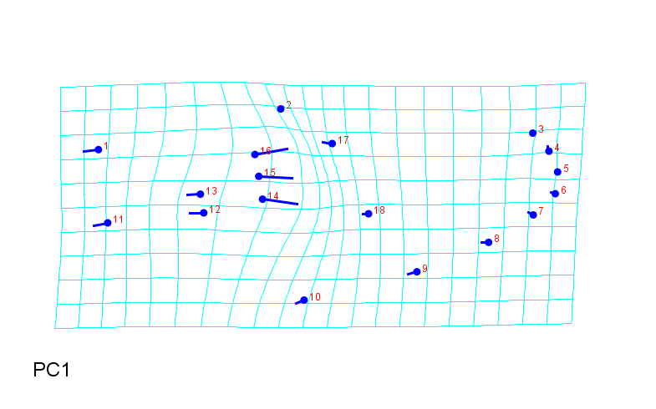
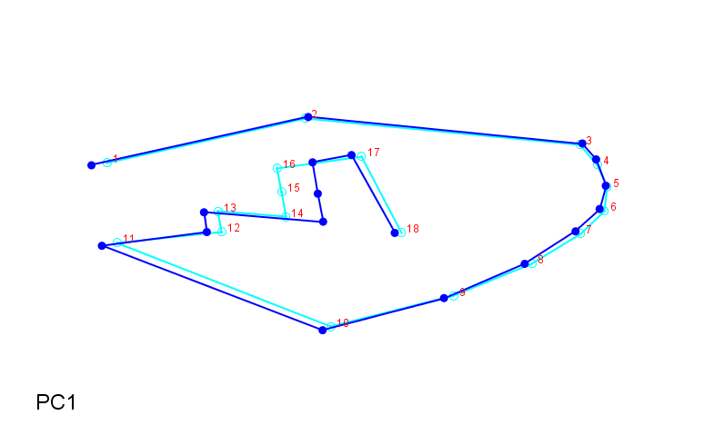
Field wing shape
Notes:
From PCA of all in Morphoj

Slide 16
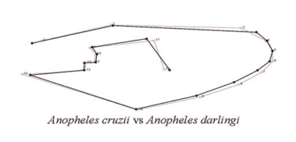
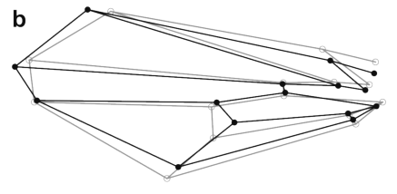
Wireframe question
Should I do this curve outline?
Or this with wing shape connections?
Wilke (2016)
It does not matter what wireframe you use. The idea with this kind of graph is to see landmark displacement when it exists.
Read:
http://www.italian-journal-of-mammalogy.it/article/view/7691
Ok, I’m reading the paper
Klingenberg (2013)
I like this kind or graph.

Slide 17

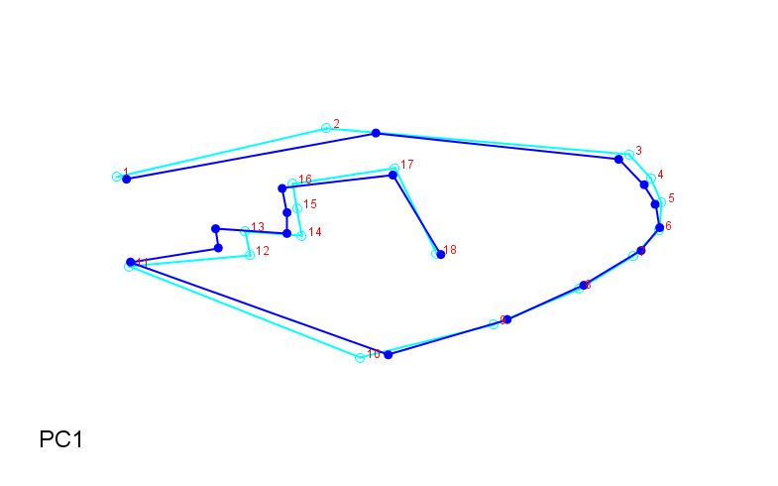
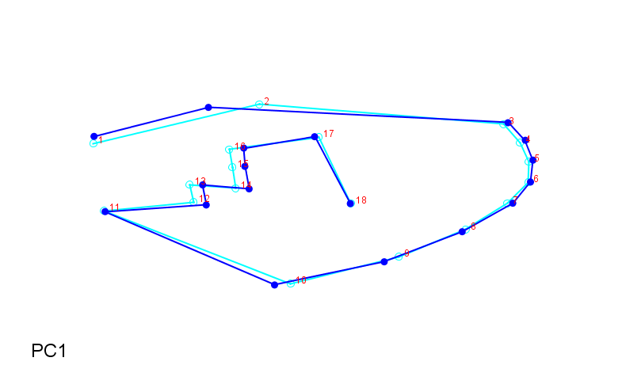
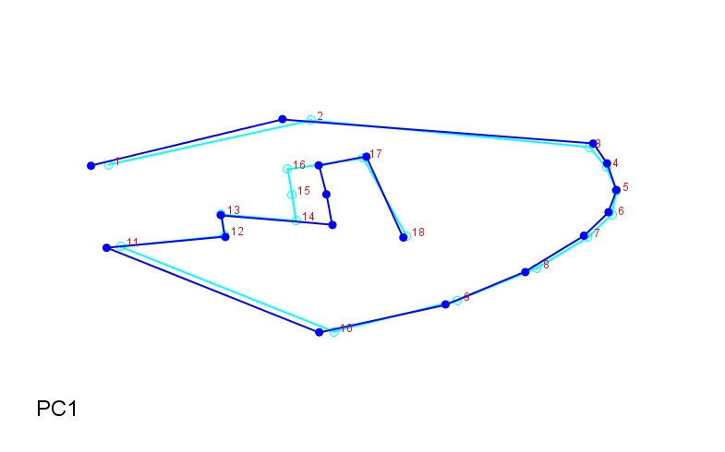
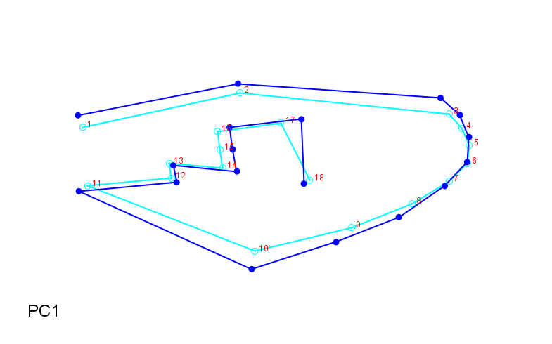
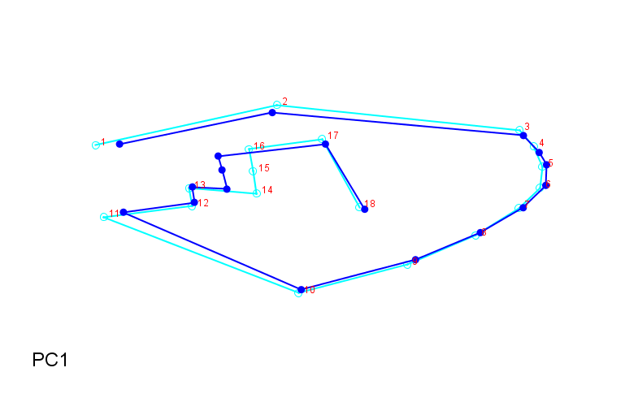
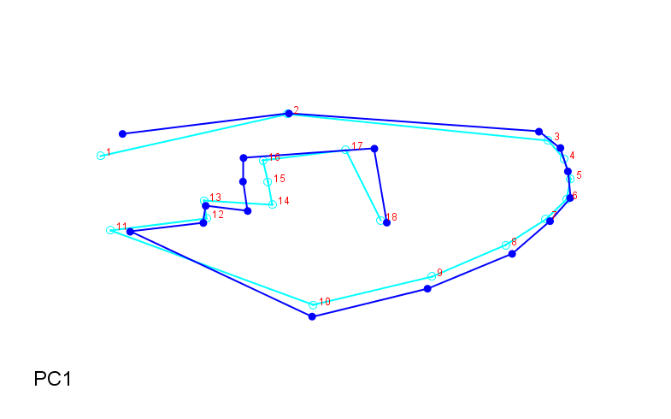
Field wing shapes by latitude
ARS
RPV
TPN
APR
RMO
TLC
SJU

Slide 18
Factorial Anova
model = lm(CS ~ Biome + Latitude + Biome:Latitude, data = fieldw)
> Anova(model, type="II")
Anova Table (Type II tests)
Response: CS
Sum Sq Df F value Pr(>F)
Biome 0.4600 2 8.8746 0.0001925 ***
Latitude 0.0940 1 3.6288 0.0580101 .
Biome:Latitude 0.0249 1 0.9612 0.3279049
Residuals 6.0907 235
---
Signif. codes: 0 ‘***’ 0.001 ‘**’ 0.01 ‘*’ 0.05 ‘.’ 0.1 ‘ ’ 1
Does it mean that biome explain CS differences ?
From this factorial ANOVA, it looks like Biome alone and not
Individual latitude explains CS?
Yes, I think so. This is why maybe the wing shape comparisons
Analysis could be done grouping by biome instead of pops. Just try!

Slide 19
MANOVA Wing length/CS
fieldres.man<-manova(cbind(Length.mm, CS)~Locality, data=fieldw)
> summary(fieldres.man,test="Wilks")
Df Wilks approx F num Df den Df Pr(>F)
Locality 6 0.57775 12.204 12 464 < 2.2e-16 ***
Residuals 233
---
Signif. codes: 0 ‘***’ 0.001 ‘**’ 0.01 ‘*’ 0.05 ‘.’ 0.1 ‘ ’ 1
> summary.aov(fieldres.man)
Response Length.mm :
Df Sum Sq Mean Sq F value Pr(>F)
Locality 6 3.2791 0.54652 18.679 < 2.2e-16 ***
Residuals 233 6.8171 0.02926
Signif. codes: 0 ‘***’ 0.001 ‘**’ 0.01 ‘*’ 0.05 ‘.’ 0.1 ‘ ’ 1
Response CS :
Df Sum Sq Mean Sq F value Pr(>F)
Locality 6 3.1201 0.52002 20.465 < 2.2e-16 ***
Residuals 233 5.9207 0.02541
fieldres.man1<-manova(cbind(Length.mm, CS)~Biome, data=fieldw)
> summary(fieldres.man1,test="Wilks")
Df Wilks approx F num Df den Df Pr(>F)
Biome 2 0.67752 25.358 4 472 < 2.2e-16 ***
Residuals 237
---
Signif. codes: 0 ‘***’ 0.001 ‘**’ 0.01 ‘*’ 0.05 ‘.’ 0.1 ‘ ’ 1
> summary.aov(fieldres.man1)
Response Length.mm :
Df Sum Sq Mean Sq F value Pr(>F)
Biome 2 3.1139 1.55697 52.848 < 2.2e-16 ***
Residuals 237 6.9823 0.02946
---
Signif. codes: 0 ‘***’ 0.001 ‘**’ 0.01 ‘*’ 0.05 ‘.’ 0.1 ‘ ’ 1
Response CS :
Df Sum Sq Mean Sq F value Pr(>F)
Biome 2 2.8312 1.4156 54.028 < 2.2e-16 ***
Residuals 237 6.2096 0.0262
---
Signif. codes: 0 ‘***’ 0.001 ‘**’ 0.01 ‘*’ 0.05 ‘.’ 0.1 ‘ ’ 1
fieldres.man2<-manova(cbind(length.mm,CS)~Biome*Latitude, data-fwing)
summary.aov(fieldres.man2)
Response Length.mm :
Df Sum Sq Mean Sq F value Pr(>F)
Biome 2 3.0569 1.52844 49.6074 <2e-16 ***
Latitude 1 0.0330 0.03296 1.0697 0.3021
Biome:Latitude 1 0.0305 0.03052 0.9905 0.3206
Residuals 236 7.2713 0.03081
---
Signif. codes: 0 ‘***’ 0.001 ‘**’ 0.01 ‘*’ 0.05 ‘.’ 0.1 ‘ ’ 1
Response CS :
Df Sum Sq Mean Sq F value Pr(>F)
Biome 2 2.7879 1.39395 52.3396 < 2e-16 ***
Latitude 1 0.0935 0.09355 3.5125 0.06214 .
Biome:Latitude 1 0.0043 0.00427 0.1604 0.68919
Residuals 236 6.2853 0.02663
---
Signif. codes: 0 ‘***’ 0.001 ‘**’ 0.01 ‘*’ 0.05 ‘.’ 0.1 ‘ ’ 1

Slide 20
MANOVA summary CS/Wing length
MANOVA results support factorial ANOVA results in comparing Biome and latitude/locality on wing length and cs.
Independently, they are each significant on both wing length and CS. But when combined, only biome alone is significant (p<2e-16) whereas latitude and their interactions are not

Slide 21
MANOVA on wing shape
Turned partial warps of 18 landmarks into matrix in R
Looks like both biome and locality are significant
fman1<-manova(f_pw_mat~fwing$Biome*fwing$Latitude)
> summary(fman1, test="Wilks")
Df Wilks approx F num Df den Df Pr(>F)
fwing$Biome 2 0.31848 4.9454 64 410 < 2.2e-16 ***
fwing$Latitude 1 0.63871 3.6237 32 205 1.162e-08 ***
fwing$Biome:fwing$Latitude 1 0.56824 4.8675 32 205 9.716e-13 ***
Residuals 236
---
Signif. codes: 0 ‘***’ 0.001 ‘**’ 0.01 ‘*’ 0.05 ‘.’ 0.1 ‘ ’ 1

Slide 22
Jackknife with MANOVA
Latitude | n | 1 | 2 | 3 | Proportion correct
Low | 67 | 40 | 27 | 0 | 66%
Mid | 163 | 21 | 139 | 3 | 85%
High | 11 | 0 | 7 | 4 | 36%
LD1 | 0.73 | 12 | 21 | 28 | 1 | 27
 |  | Assignments
Locality | (n) | ARS | APR | RPV | RMO | TLC | TPN | SJU | Proportion correct
ARS | 17 | 3 | 9 | 1 | 4 | 0 | 0 | 0 | 18%
APR | 50 | 6 | 22 | 5 | 12 | 5 | 0 | 0 | 44%
RPV | 47 | 0 | 2 | 37 | 0 | 2 | 6 | 0 | 79%
RMO | 45 | 2 | 9 | 0 | 26 | 8 | 0 | 0 | 58%
TLC | 54 | 1 | 3 | 2 | 2 | 44 | 0 | 2 | 81%
TPN | 17 | 0 | 0 | 9 | 0 | 2 | 5 | 1 | 29%
SJU | 11 | 0 | 1 | 0 | 3 | 2 | 0 | 5 | 45%
LD1,2,3 | .8953
Most important PW |  | 5 | 3 | 11 | 28 | 14
Biome | n | Amazon | Cerrado | Mata Atlantica | Proportion correct
Amazon | 159 | 138 | 20 | 1 | 87%
Cerrado | 71 | 23 | 47 | 1 | 66%
Mata Atlantica | 11 | 4 | 3 | 4 | 36%
LD1 | 0.81 | 12 | 30 | 11 | 26 | 1
Did a MANOVA and jackknife population discrimination
MANOVA found both Biome, Lat group, and locality are significant on Partial warps
Jack knife- most important PWs change with classification. PW12 and 1 were both important for Latitude/Biome
I think low similarity in ARS and high similarity in RPV are causing the shifts in %correct between Biome and Latitude group.

Slide 23
Conclusions?
Wing length and CS highly correlated (significant)
Evidence of Bergmann cline (significant)
Wing size
Biome, not individual locality, significantly affects length/CS
Wing shape
Individual localities have higher variability. Significant differences between all groups by CVA
Grouping best by Biome or Latitude group (MANOVA jack knife)

